Slide 1

Early-Stage Disease Prediction
Using Integrated Lifestyle and Clinical Data with Explainable Machine Learning Models
The Coversheet
Student Name (unless anonymised) | Sarjan Bahadur Thapa
Student Number (as shown on student ID card): | 260043443
Word Count / Pages / Duration / Other Limits:
Assessment component number (1,2 or 3) | 1
Assessment type | Proposal presentation
Attempt Number: | 1
Date of Submission: | 14th May 2026, 12Noon

Slide 2

I have read and understood the Academic Misconduct statement. | Tick to confirm ☐
I have read and understood the Generative Artificial Intelligence use statement. | Tick to confirm ☐
I am satisfied that I have met the Learning Outcomes of this assignment (please check the Assignment Brief if you are unsure) | ​​​ Met ☐
Self-Assessment – If there are particular aspects of your assignment on which you would like feedback, please indicate below. Optional for students
Suggested prompt questions- How have you developed or progressed your learning in this work? What do you feel is the strongest part of this submission? What feedback would you give yourself? What part(s) of this assignment are you still unsure about?

Slide 3

Table of Content
Introduction
Project Overview
Expected Outcomes & Impacts
Problem Statement
Innovative Solution
Methodology
Timeline
Future Work
Conclusion
References
Ethics Consideration

Slide 4
Introduction
Timely detection plays an important role in enhancing the length of patient survival and lowering healthcare costs.
The traditional diagnostic approach can take a long time to diagnose diseases.
By leveraging patient information, Machine Learning (ML) can help to more accurately and rapidly forecast illness.
The integration of lifestyle and clinical data for early-stage disease prediction in this project.
New techniques in Explainable AI (XAI) like SHAP and LIME are applied to enhance transparency and trust in predictions.
The purpose of the research is to create doctors' intelligent and data-driven decision making systems.

Slide 5
Project Overview
The aim of this project is to build an intelligent system for prediction of the disease at an early stage using Machine Learning techniques.
The study includes clinical data (blood pressure, cholesterol level, glucose level, BMI) and lifestyle data (smoking, exercise, diet).
Various Machine Learning models like Logistic regression, Decision Tree, Random Forest and SVM will be compared.
Techniques such as Data Pre-processing (data cleaning, data normalization, and feature selection) will be employed to enhance the model performance.
Predictions will be made transparent and understandable using Explainable AI (XAI) techniques, such as SHAP and LIME.
The accuracy, precision, recall, F1-Score, and ROC-AUC will be used to assess the system's performance.
The project is designed to assist a healthcare provider in more effective and expeditious clinical decisions.

Slide 6
Expected Outcomes & Impacts
Implementing an accurate early stage disease prediction system with Machine Learning.
Identification of important health risk factors such as age, cholesterol, blood pressure, and lifestyle habits.
Increased transparency and trust with Explainable AI methods (SHAP/LIME).
Assistance to physicians in quicker and evidence-based clinical decisions.
Early diagnosis, better patient outcome and survival rate.
Lower health-care expenses due to prevention diagnosis and treatment.
Support of AI and medical information analytics research.

Slide 7
Problem Statement
Many diseases are identified when it is too late, making it difficult to treat and patient survival rates lower.
The traditional diagnosis methods rely on manual assessment and clinical experience is highly dependent and slow.
A lot of patient data (clinical + lifestyle) is available but not used to the full extent for early prediction.
Currently, most models are limited to clinical data and neglect other lifestyle factors of importance.
Many AI healthcare systems are not explainable, which is why it's hard for doctors to trust and use.
An accurate, transparent and explainable machine learning system for early prediction of disease is needed.

Slide 8
Innovative Solution
Development of a hybrid machine learning system that can utilize both clinical data and lifestyle data to achieve more accurate disease prediction.
Application of several ML algorithms to determine which algorithm has best performed results (Logistic Regression, Decision Tree, Random Forest, SVM).
Using feature selection methods to reduce the size and accuracy of the model. Explainable AI (SHAP & LIME) integration to deliver interpretable and explainable predictions.
Development of decision-making tool that aids early detection of disease.
Emphasize the development of an accurate, interpretable, and clinically applicable model for real-world health care applications.

Slide 9
Methodology
Data Collection:
Collect healthcare datasets from sources such as Kaggle and UCI Machine Learning Repository, including clinical and lifestyle attributes.
Data Preprocessing:
Clean the dataset by handling missing values, removing duplicates, and correcting errors. Apply normalization and scaling techniques.
Feature Selection:
Identify the most relevant features (e.g., age, blood pressure, cholesterol, lifestyle factors) to improve model performance.
Model Development:
Train and test multiple machine learning algorithms such as Logistic Regression, Decision Tree, Random Forest, and SVM.
Model Evaluation:
Evaluate models using performance metrics including Accuracy, Precision, Recall, F1-score, and ROC-AUC.
Explainable AI (XAI):
Use SHAP and LIME to interpret model predictions and understand feature importance.
Final System:
Develop a reliable early disease prediction model to support healthcare decision-making.

Slide 10
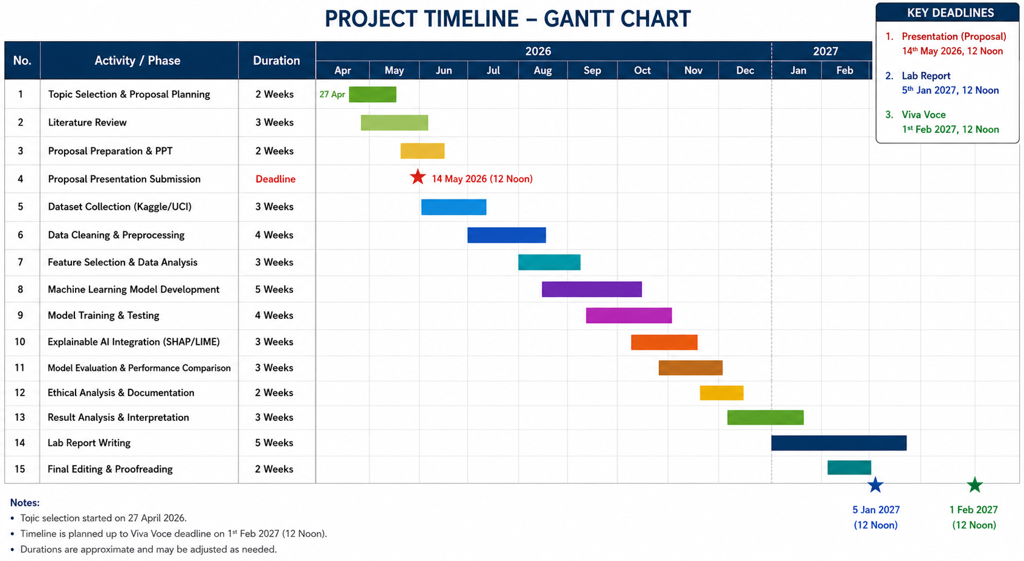
Timeline

Slide 11
Future Work
Increase the patient population of the dataset with more and larger patient data sets for better model generalization.
Connect Health Data in real time with wearable technology and electronic health records (EHRs).
Look at the latest deep learning models and their benefits for higher prediction accuracy.
Improve the Explainable AI approaches for even better clinical interpretation.
Create a web or mobile application suitable for deployment in the real world in the health sector.
Work with healthcare institutions to validate and test. Expand model to forecast more diseases than were intended.

Slide 12
Conclusion
This project shows how Machine Learning can be used to make predictions at an early stage.
The integration of clinical data and lifestyle data enhances the accuracy and reliability of the prediction.
Explainability AI techniques bring transparency and enhance trust in the model among health care professionals.
The system can assist doctors in quicker and better clinical decision making.
Overall, the project highlights how AI and data analytics can enhance early diagnosis and improve healthcare outcomes.

Slide 13
References
Bishop, C.M. (2006) Pattern Recognition and Machine Learning. New York: Springer.
Géron, A. (2022) Hands-On Machine Learning with Scikit-Learn, Keras, and TensorFlow. 3rd edn. Sebastopol, CA: O’Reilly Media.
James, G., Witten, D., Hastie, T. and Tibshirani, R. (2021) An Introduction to Statistical Learning: With Applications in Python. 2nd edn. New York: Springer.
Kaggle (2026) Healthcare Datasets for Machine Learning. Available at: https://www.kaggle.com/ (Accessed: 12 May 2026).
Kuhn, M. and Johnson, K. (2013) Applied Predictive Modeling. New York: Springer.
Molnar, C. (2022) Interpretable Machine Learning. 2nd edn. Available at: https://christophm.github.io/interpretable-ml-book/ (Accessed: 12 May 2026).
UCI Machine Learning Repository (2026) Machine Learning Datasets. Available at: https://archive.ics.uci.edu/ml/index.php (Accessed: 12 May 2026).
World Health Organization (2023) Cardiovascular diseases (CVDs) fact sheet. Available at: https://www.who.int/news-room/fact-sheets/detail/cardiovascular-diseases-(cvds) (Accessed: 1 May 2026).

Slide 14
Ethics Consideration
Patient Data Privacy: Patient data should be anonymised and protected according to GDPR regulations.
Data Security: Ensuring secure data storage and controlled access to prevent misuse of sensitive health-related information.
Bias & Fairness: Models should be checked for bias to prevent unfair/discriminatory predictions.
Explainability: Ensure predictions are interpretable and trustworthy using Explainable AI (SHAP/LIME).
Medical Responsibility: The system must be used as a medical decision support system and not as a substitute for medical practice.
Data Usage Ethics: Data for research should be used from publicly available and/or ethically approved sources.

Slide 15
Thank you

